Slide 1

“””Hibachi or Not to Hibachi”
Presented by: Team 6

Slide 2

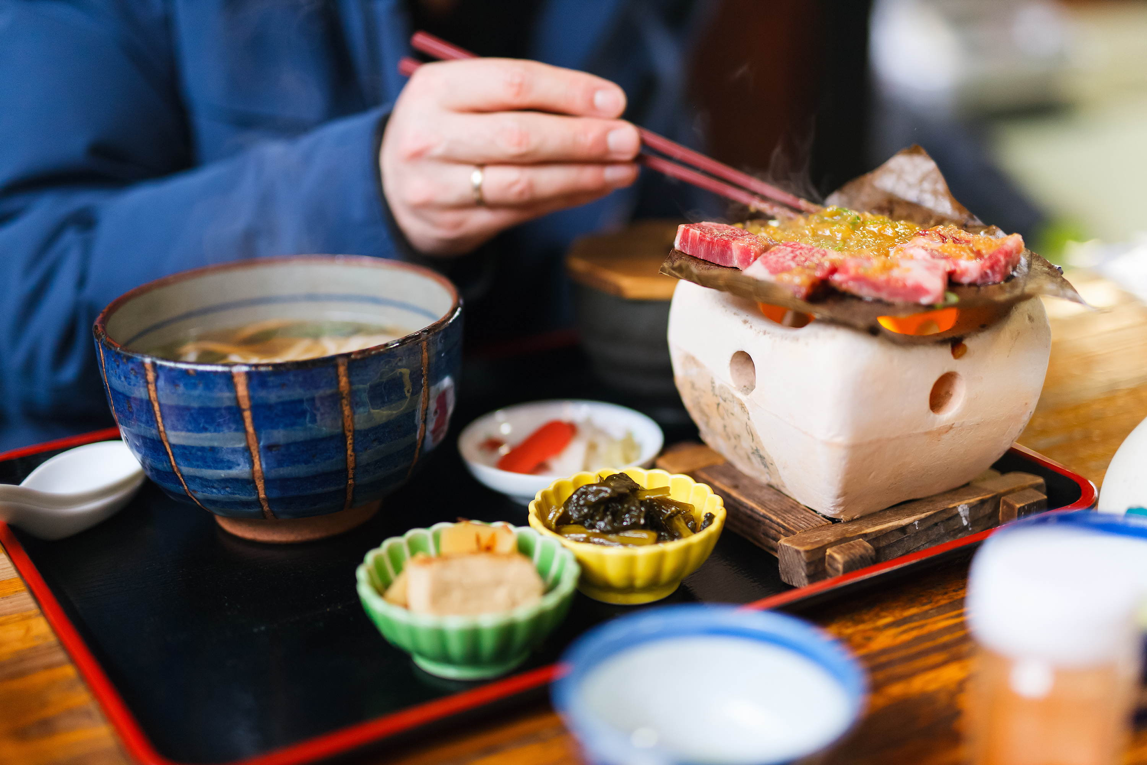


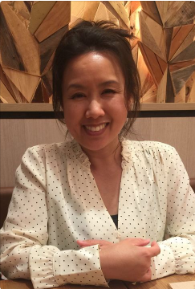

THE TEAM
THE TEAM
Chris Ng
Freelance Writer
Gillian Gadiano
Medical Professional
Caroline Schurter
Real Estate Professional
Johnny Saniel
IT Professional

Slide 3
SCENARIO
A young, multi-millionaire entrepreneur is seeking to start a new business venture in the restaurant industry
Hibachi-style Japanese food is one of his favorite foods to eat
He dreams of building a new Hibachi restaurant preferably near popular spots in the northern coastal cities near San Diego
He is requesting assistance in determining where to open his new restaurant
Notes:
Considerations include:
Find a spot that draws crowds
easily accessible
potential for growth
location that fits within the budget

Slide 4
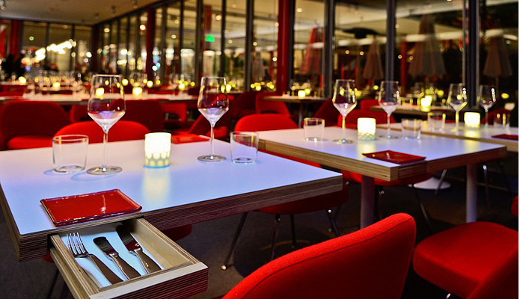
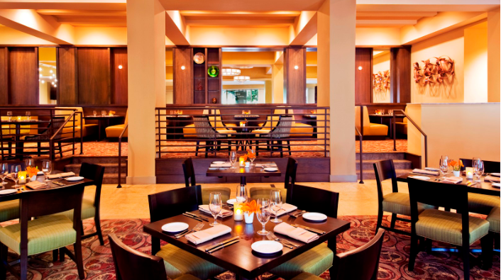
GOAL STATEMENT
To investigate whether to open a Hibachi restaurant in Carlsbad, Encinitas or Oceanside
Which type of restaurants am I competing against in each city?
Who are my direct competitors in each city?

Slide 5



DATA SOURCES
Restaurant categories
Review counts
Restaurant ratings
Price
Location (Latitude/ Longitude)
Plotting heat maps
Yelp API
Google Maps

Slide 6


CHALLENGES
Changing projects
Unavailable APIs/ Data
Accessing Yelp API
Able to use Postman and YelpAPI wrapper to access Yelp data
API search result limits
Plotting data
Heat maps

Slide 7
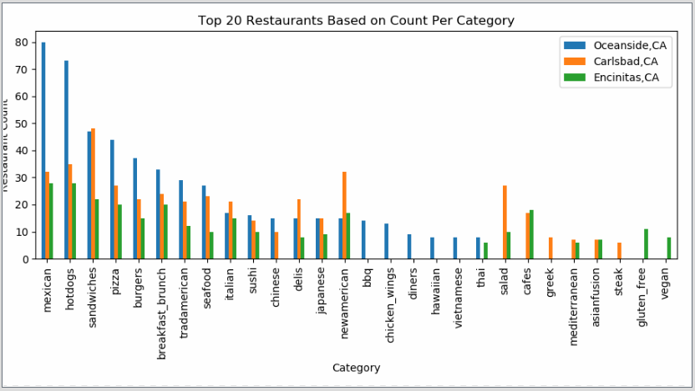
Which types of restaurants am I competing against in each city?
Top 20 restaurants based on Count per category
Notes:
The most restaurants organized by category
More restaurants in Oceanside compared to others
There are more fast and cheaper options in Oceanside
Carlsbad has a wide variety of restaurants. Same as Encinitas however Encinitas has lower count of restaurants

Slide 8
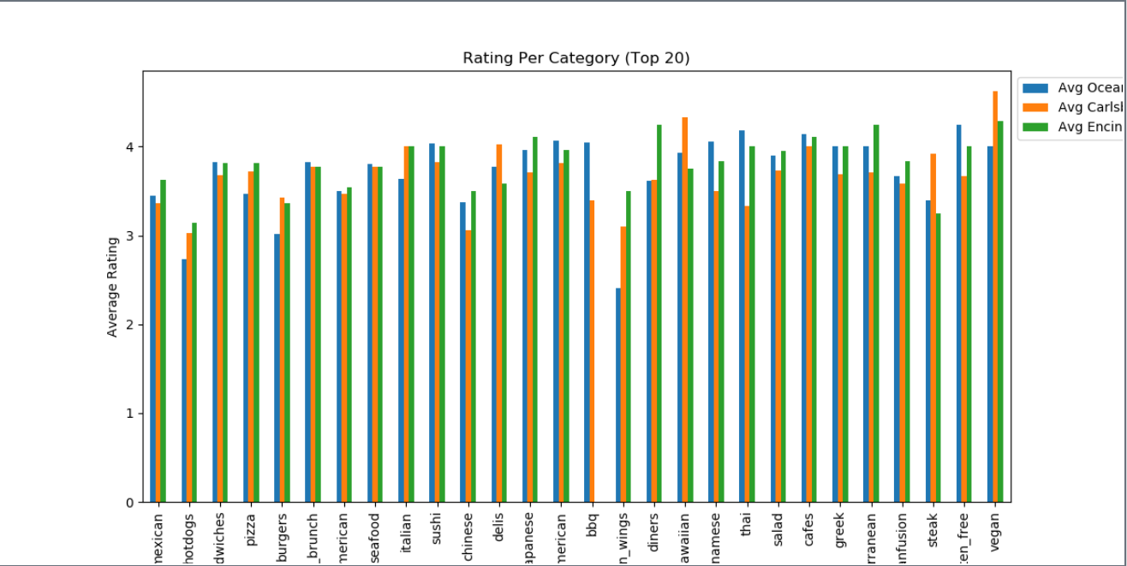
Which type of restaurants am I competing against in each city?
Rating per Category (Top 20)
Notes:
Based on those top 20 counts, these are the ratings for those categories
We can see that the majority of these restaurants are averaging 2.5 and above

Slide 9
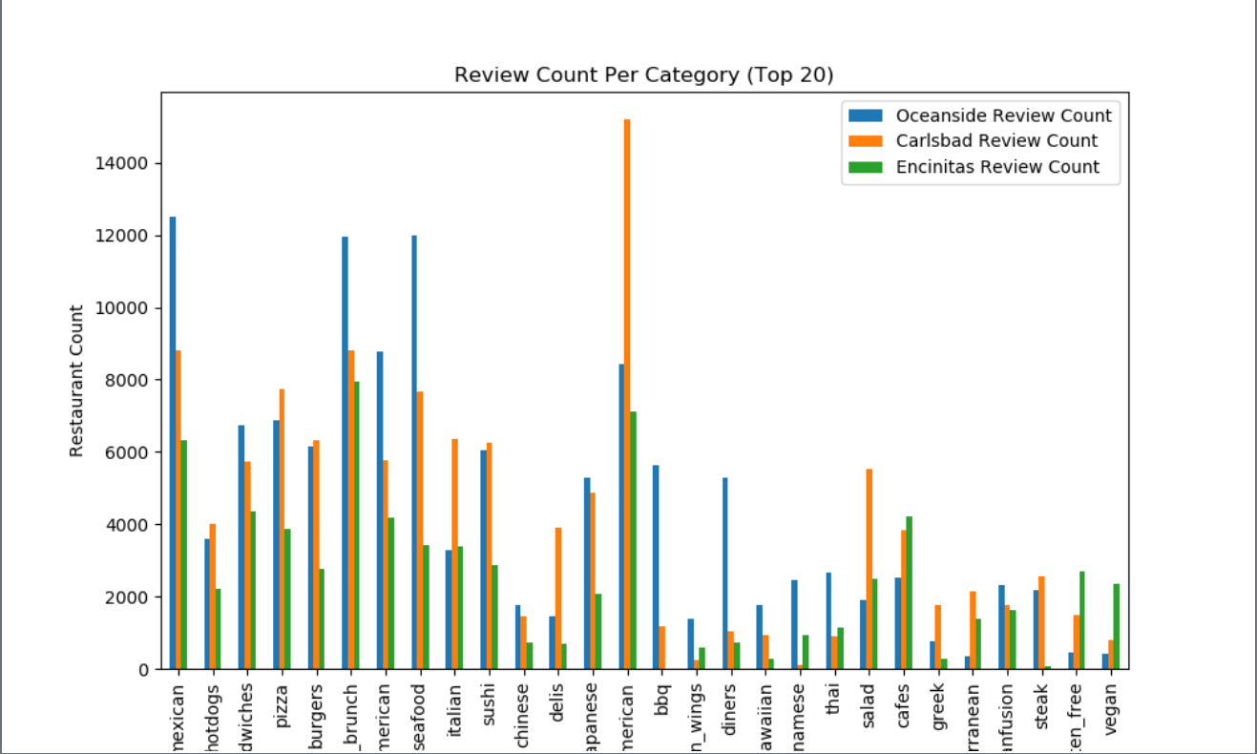
Which type of restaurants am I competing against in each city?
Review count per category (Top 20)
Notes:
From those rating, these are the number or review counts
We can see that New American Restaurants in Carlsbad are highly reviewed and averaging to 3.5 stars
Mexican and Brunch are the next most heavily rated restaurants
Mexican averaging to 3.5 stars
Brunch about 3.7 stars

Slide 10
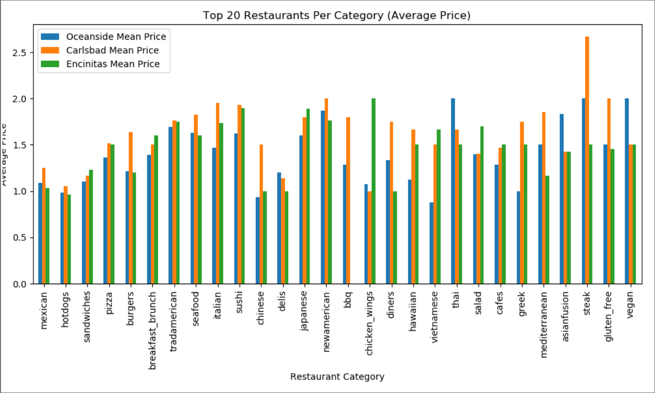
Which type of restaurants am I competing against in each city?
Top 20 Restaurants per category by Price
Notes:
In this graph, its showing the average price for the top 20 categories
The average price tends to be in the 1-2 “$” range

Slide 11
Who are my direct competitors in each city?
Investigate similar categories to Hibachi
Japanese
Asian Fusion
Sushi
Hibachi
Average review count per competitor category
Average rating per competitor category

Slide 12
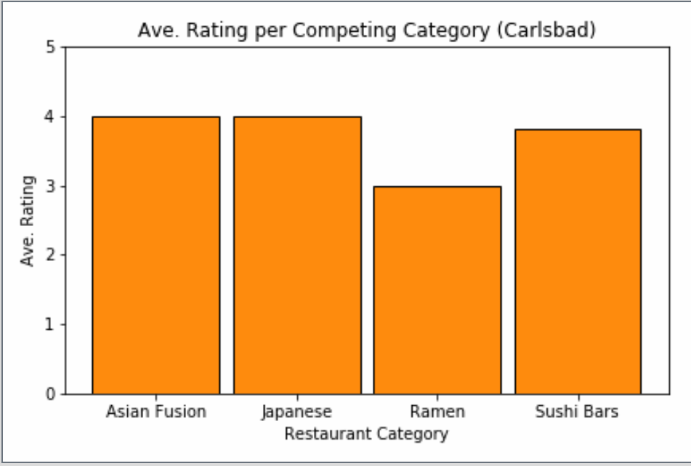
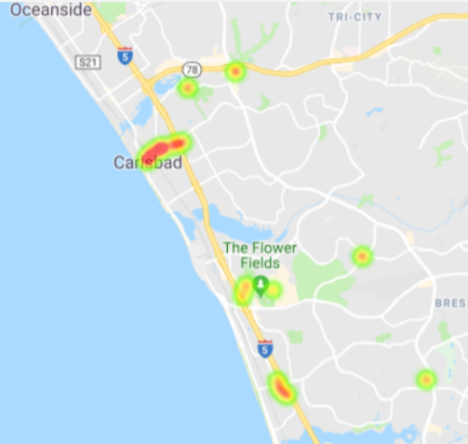
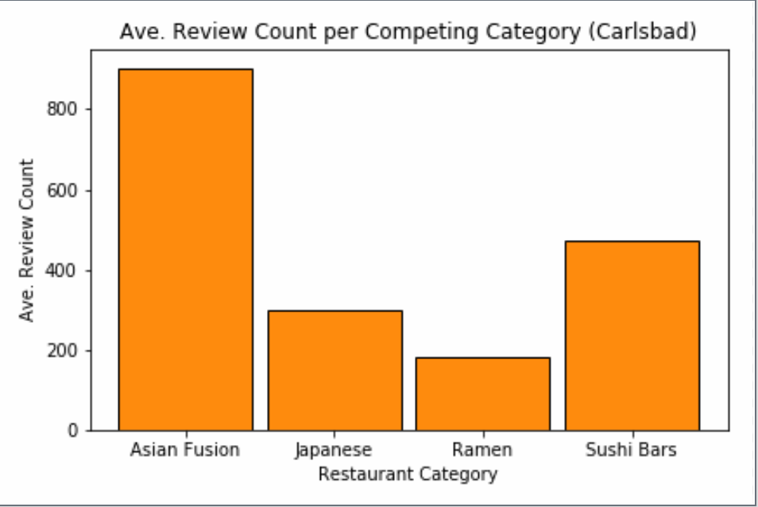
Who are my direct competitors in each city?
Competitors in Carlsbad

Slide 13
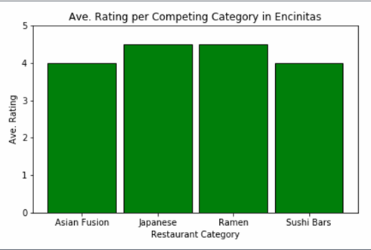
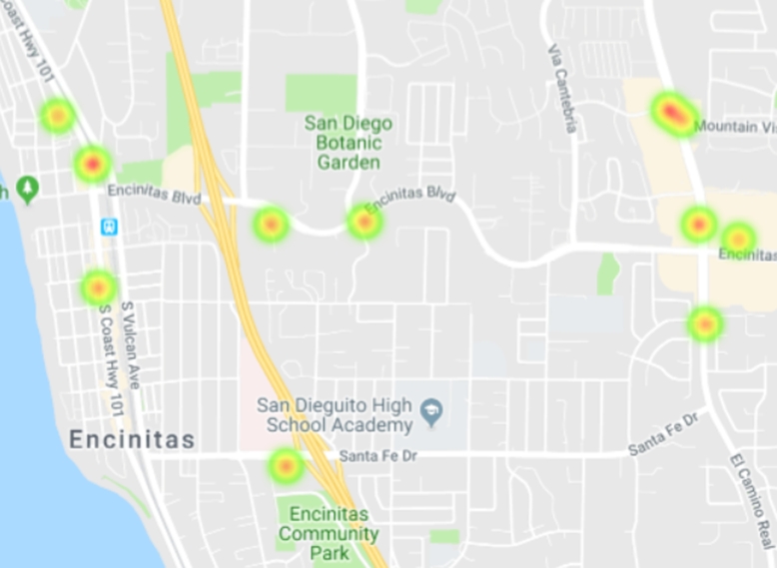
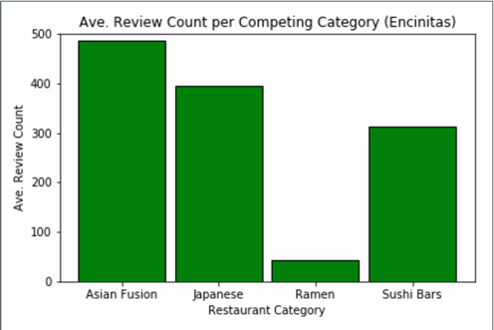
Who are my direct competitors in each city?
Competitors in Encinitas

Slide 14
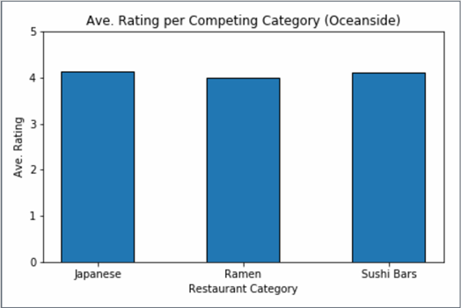
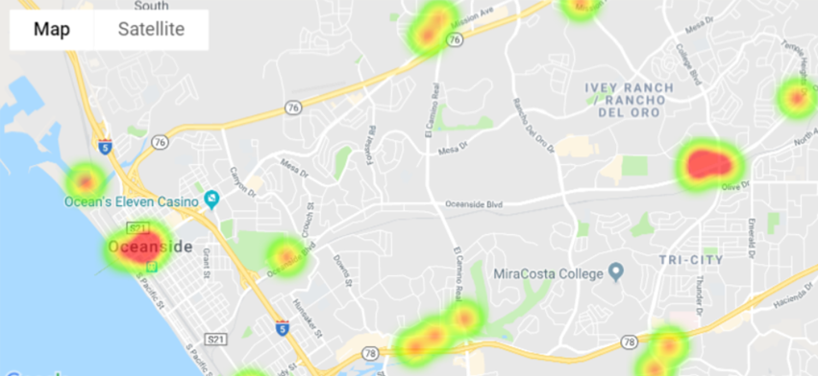
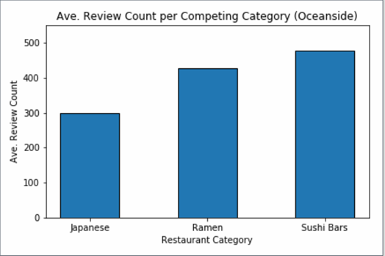
Who are my direct competitors in each city?
Competitors in Oceanside

Slide 15
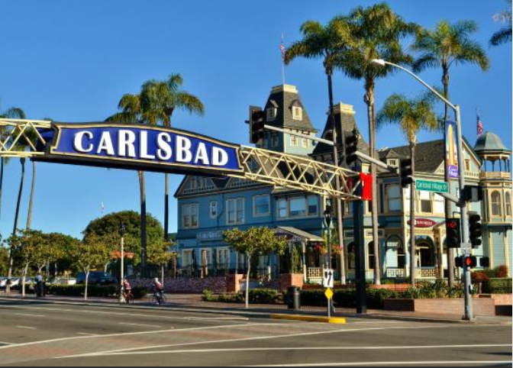
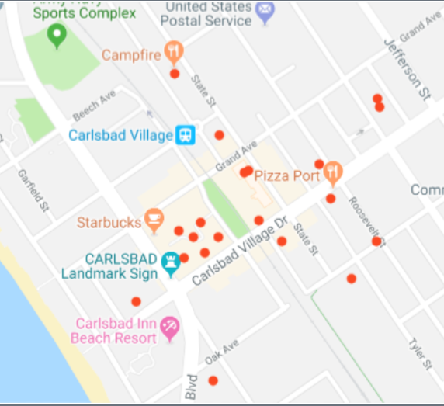
CONCLUSION
Carlsbad is the best place to open a Hibachi restaurant
Most diverse selection of restaurants
Asian Fusion category had the highest average review count
The restaurants are mostly centrally located
Using competitors for increase visibility
More average Yelp reviewers
15

Slide 16
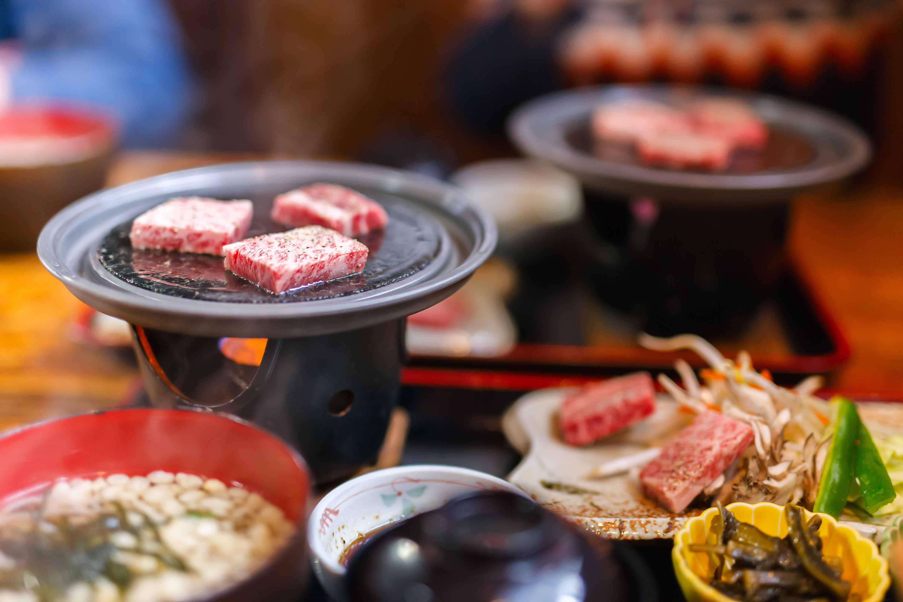


How could you improve your analysis in the future?
THANK YOU!
Click icon to add picture
Limitations
Yelp users
No analysis of city demographics
No past history of Hibachi restaurants
No data on specific competing restaurants
Improvements
Include other restaurant APIs
Census data
Interactive Google maps
Client decisions
City business history
Speaker Name
Email:
speakeremail@website.com
Phone:
+7 888 999-000-11

Slide 17

Thank You!

